Slide 1

Module 5: SMA-X Request management & Fulfillment
Jan 2018
Notes:
[STANDARD SLIDE: L300 (animated)]
You can change out the photo with any image from Getty Images in DropBox.
The module number is listed in the title and explicit instructions for downloading the PPT are mentioned in the notes.
You may have to adjust the title font size or increase the size of the text box to make things fit.
You may have to move the title text around depending on the photo. Make sure the text is readable against the background photo.
You can change the background color for the rectangle in the bottom-right corner to look better against the background. Choose a Micro Focus color at 25% transparency.
=========================
Note to Narrator or Reader: [PRESS] indicates press the Page Down key to show the animation
=========================
Hello and Welcome to Module X of [COURSE_NAME] Technical Overview Training, Level 300.
[If this is the first module, mention: “There are X modules in this course that explore detailed technical information about PRODUCT_NAME”]
In this course you’ll gain a high-level understanding of the essentials of [PRODUCT_NAME].
[PRESS] If you want to download this presentation and save it on your own system, click the Tools & Help icon in the bottom-right corner of your window and select Download.
Or, if you want to access the PPT slides and speaker notes for future reference, go to the Attachments tab in your window and click to download the presentation. This is very useful when you later prepare for the comprehensive Certification Exam.

Slide 2
Objectives
After completing this module, you should be able to:
Describe key features of Service Request Management
Describe the Support Request and Service Request workflows
Understand the interactions between IT Agent and ESS User
Understand Social Collaboration between IT Agents
Use Live Support

Slide 3
Service Request Management Overview

Slide 4
Service Request Management Overview
Service Request module enables you to create, escalate, execute and monitor requests.
Requests may be either:
Service Request based on a Service Offering
Support Request based on a Support Offering
Generic Support request
Initiated from different sources:
Self-Service Portal
Agent IT Interface
Live Support (Computer Telephony Integration)
Email Integration
External System

Slide 5
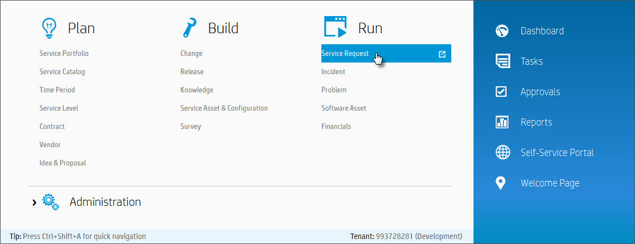
IT Agent Accessing Service Request Management
Mega Menu > Run > Service Request

Slide 6
Service Request Management Overview
Service Request and Support Request
Service Requests are the set of predefined activities that can be performed against the service itself. Each one may follow a standard task plan and approval plan.
Support requests, by contrast, encompass those requests whereby the end user can request help from IT for some of the most common problems. These may or may not have been predefined or even expected by the service owner.
Additional memory for VM
Reset a password
Increase mailbox size
Application is running slow
How do I upload a file to SharePoint?
Cannot connect to Lync

Slide 7
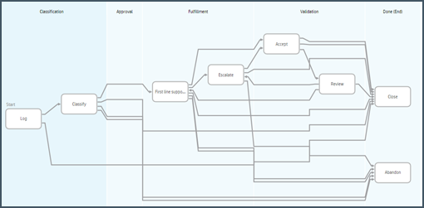
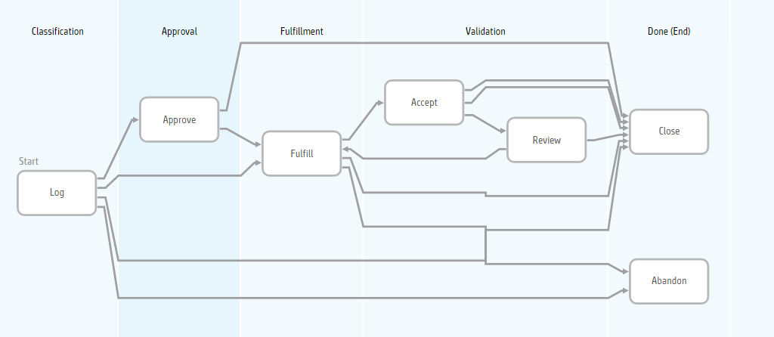
Service Request Management Overview
Support and Service Requests
Support Requests
Faster resolution for support requests by providing
Real-time communication between IT Agent and Requester
Integrated smart search capabilities, powered by HP Autonomy IDOL
Social Insight integration to reduce resolution time and increase customer satisfaction
Records historical conversations between Requester and IT Agent
Tracks collaboration discussions between IT Agents
Service Requests - Fulfillment
Execute dedicated fulfillment task plans for Service fulfillment and change
Assign manual tasks and delegate to other fulfillment processes
Orchestrate automated fulfillment tasks

Slide 8
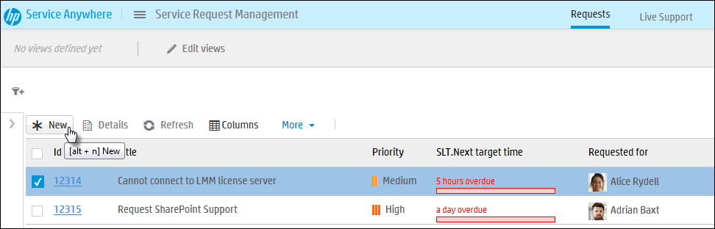
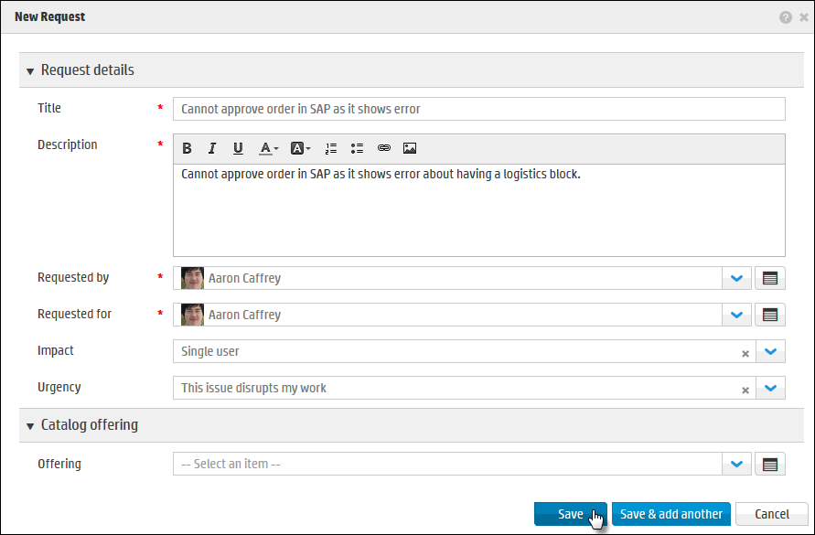
How to Open a New Request – Recap
A new request can be opened from the Service Request List, or from Live Support
From Service Request List, click New button.
This is the New Request form
In the New Request form, fill in details and click Save.
Can use a Catalog Offering

Slide 9
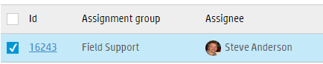
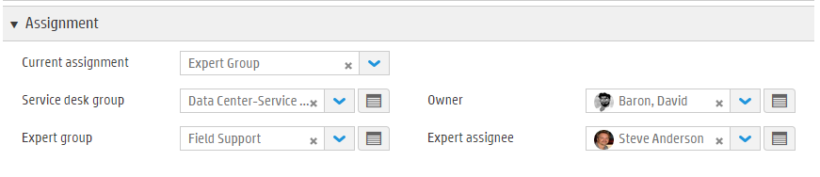
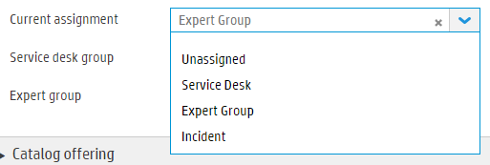
Assignment
Assignment can be based on different kinds of business rules:
Routing definitions
Groups defined at Actual Service level
Groups related to other field values
Consistent for Request and Incidents
Three pairs of group & person fields
Assignment Group & Assignee
who is currently assigned to the record
Used on list views and in filter criteria
Not shown on detail pages
Service Desk Group & Owner
Expert Group & Expert assignee
Current Assignment
Possible values of:
Unassigned, Service Desk, Expert Group
Assignment Group & Assignee set based on value
Notes:
Assignment can be based on different kind of rules:
Routing definitions
Groups defined at Actual Service level
Groups related to others
…

Slide 10
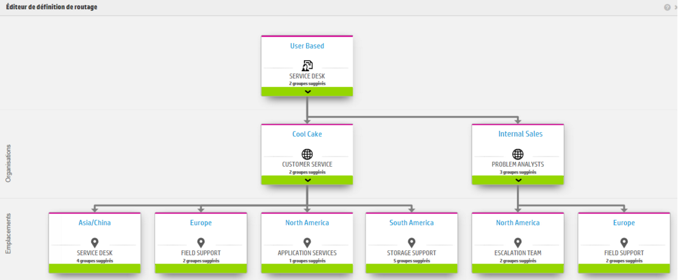
Routing Definition
Routing Definitions can provide Suggested values based on routing definition depending on Service, Organization and/or location
Leverage Big Data suggested values:
Assignment fields
Service auto-suggestion (Incident and Request)
Offering (Request)
Notes:
Routing Definitions can now be used to provide suggestions for the agent when filling in a Group field (in addition being used to set a Group field).

Slide 11
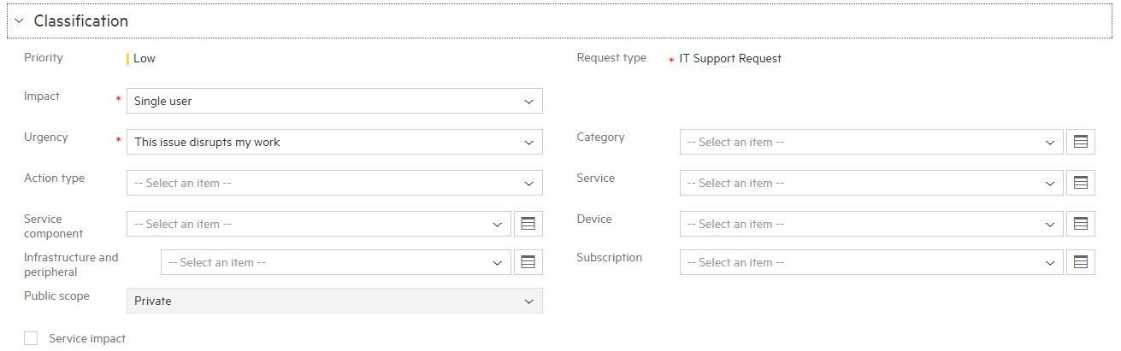
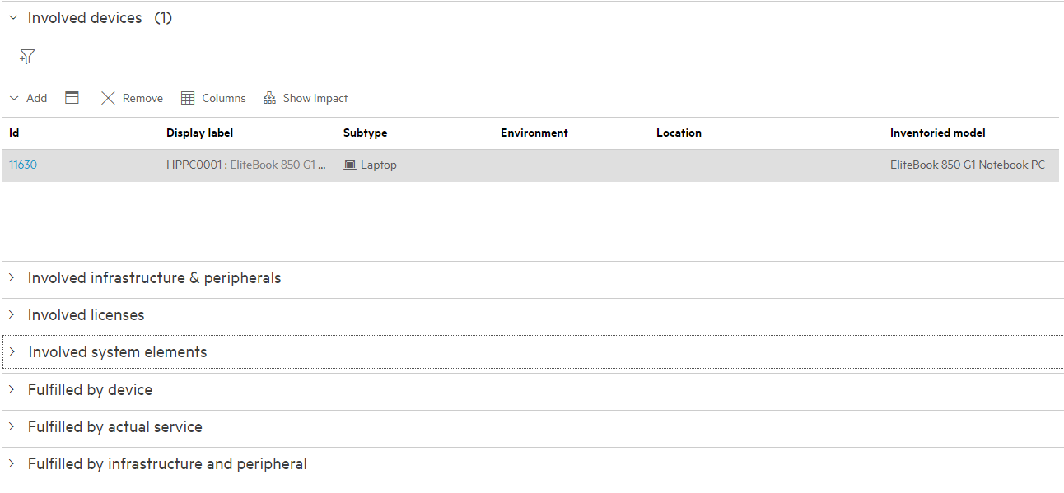
SACM references in Requests
Classification:
Actual Service
Service Component
Device
Infrastructure & peripheral
Involved CIs tab:
Involved devices
Involved Infrastructure & peripherals
Involved Licenses
Involved system elements
Fulfilled by device
Fulfilled by actual service
Fulfilled by infrastructure and peripheral

Slide 12
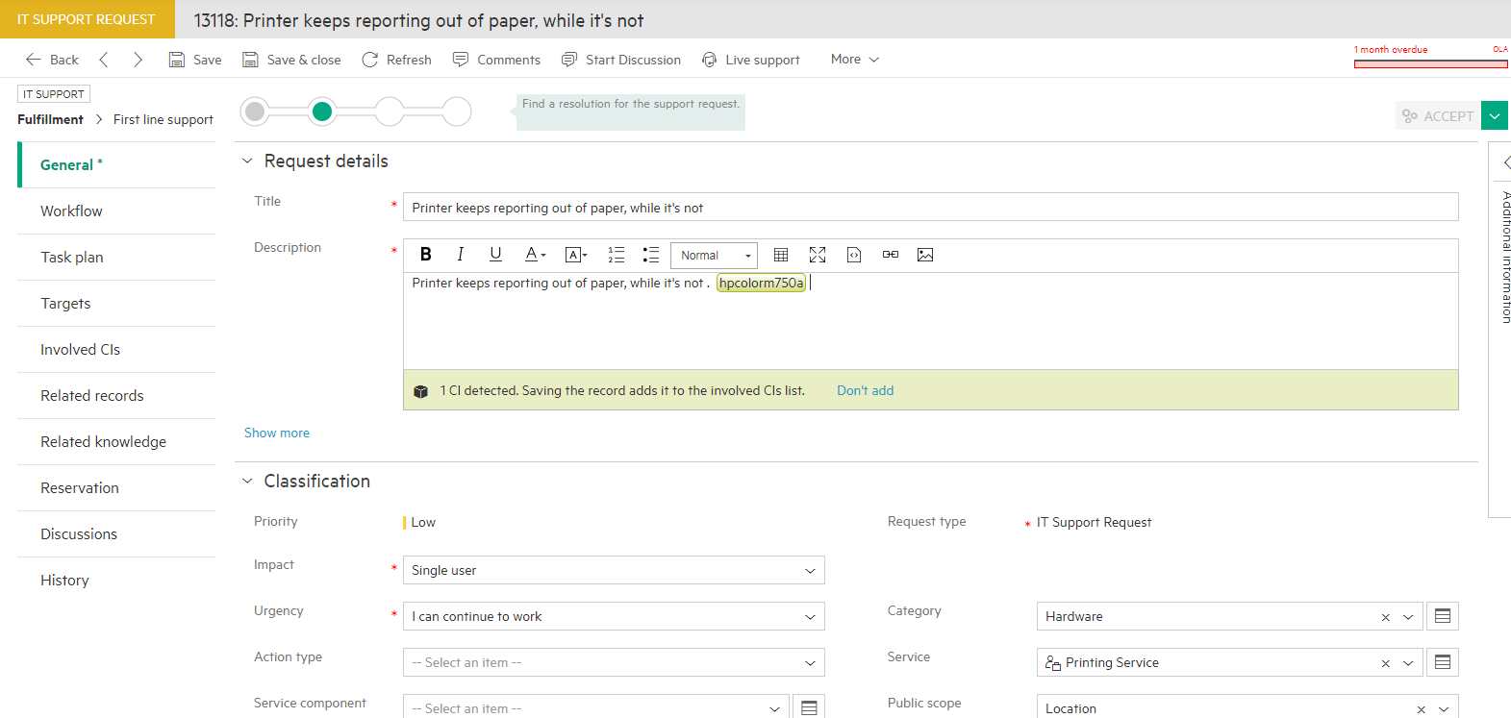
CI Detection
Automatic CI detection
Analyze content of request/incident description and incident solution
Automatic highlight of asset/Cis in the text
Seamless linking of CI to the ticket
Importance of linking impacted CIs
This helps increase the quality of the ticket, speeding resolution and reducing ticket volume
Helps reduce creation of duplicate tickets for the same asset

Slide 13
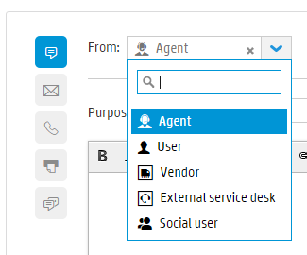
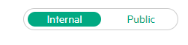
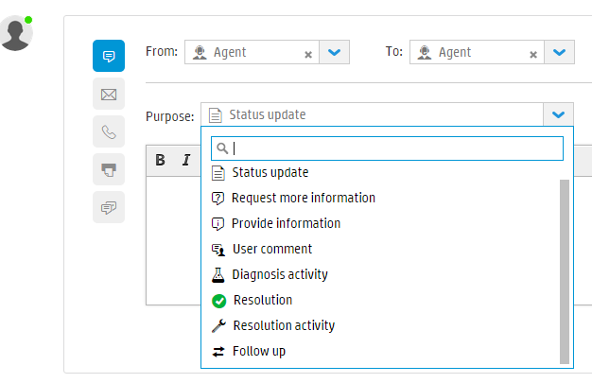
Discussions tab
Discussions entry types
Agents can flag a discussion comment with a type
E.g. : Internal comment, communication with Vendor, Customer Update, etc…
E.g. : Public comment, communication with Requestor (displayed on the Self-Service Portal)
Comment Based Events and BR Processing
Enables configurable uses cases
Flag records as updated
Propagate comments from incident to Request
Suspend request depending on Comment’s purpose

Slide 14
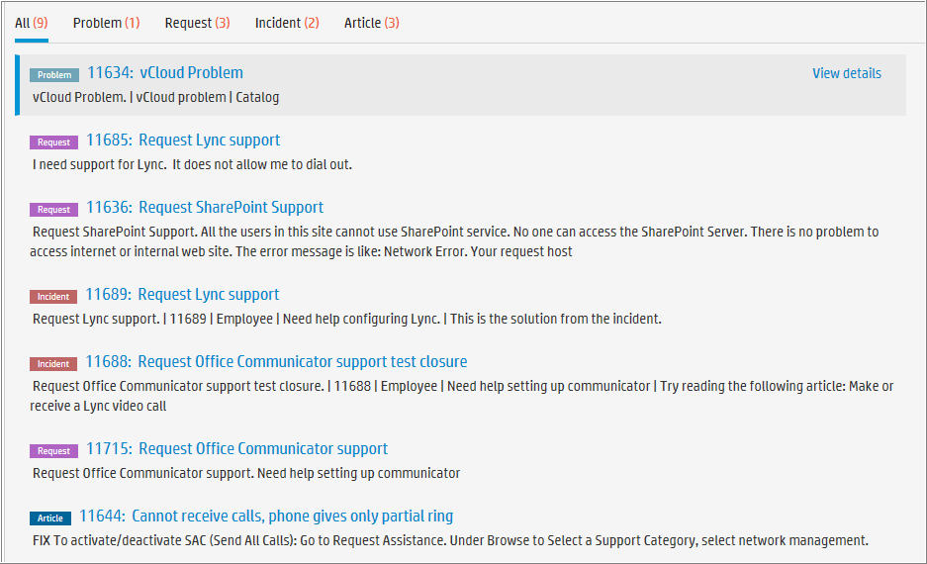
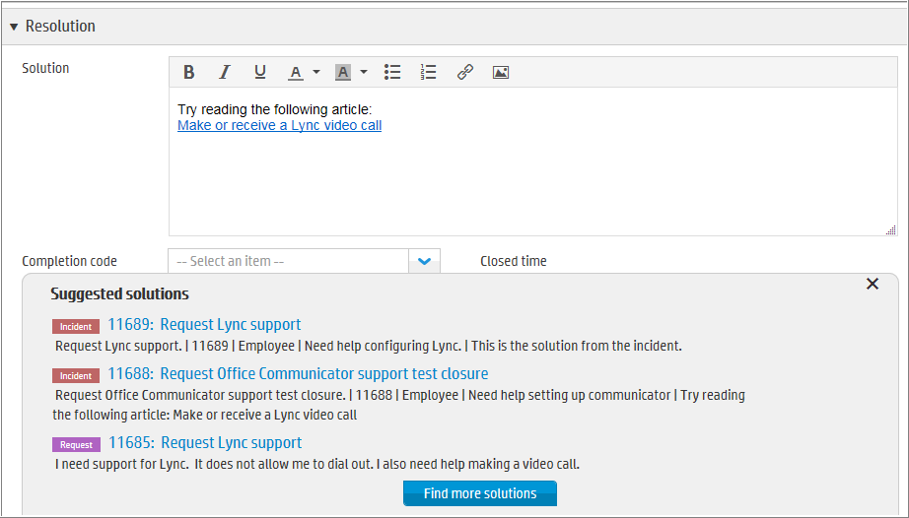
Suggested Solutions
Based on request context: Title and Description
Allows agent to view knowledge
Provide step-by-step instructions
Copy steps or link and send to user
Suggested Solutions
Top three matching Request, Incidents, Problems, Changes, Releases or Articles
Find more solutions
More matching Request, Incidents, Problems, Changes, Releases or Articles
Notes:
When providing the Solution and the Completion Code and saving, the request will automatically transition to the Accept phase

Slide 15
Support Request Workflow

Slide 16
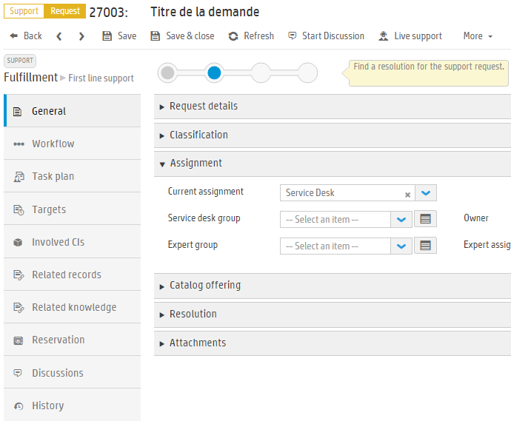
Support Request
Record content

Slide 17
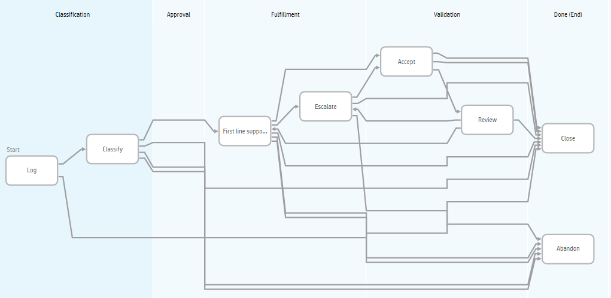

Support Request Workflow

Slide 18
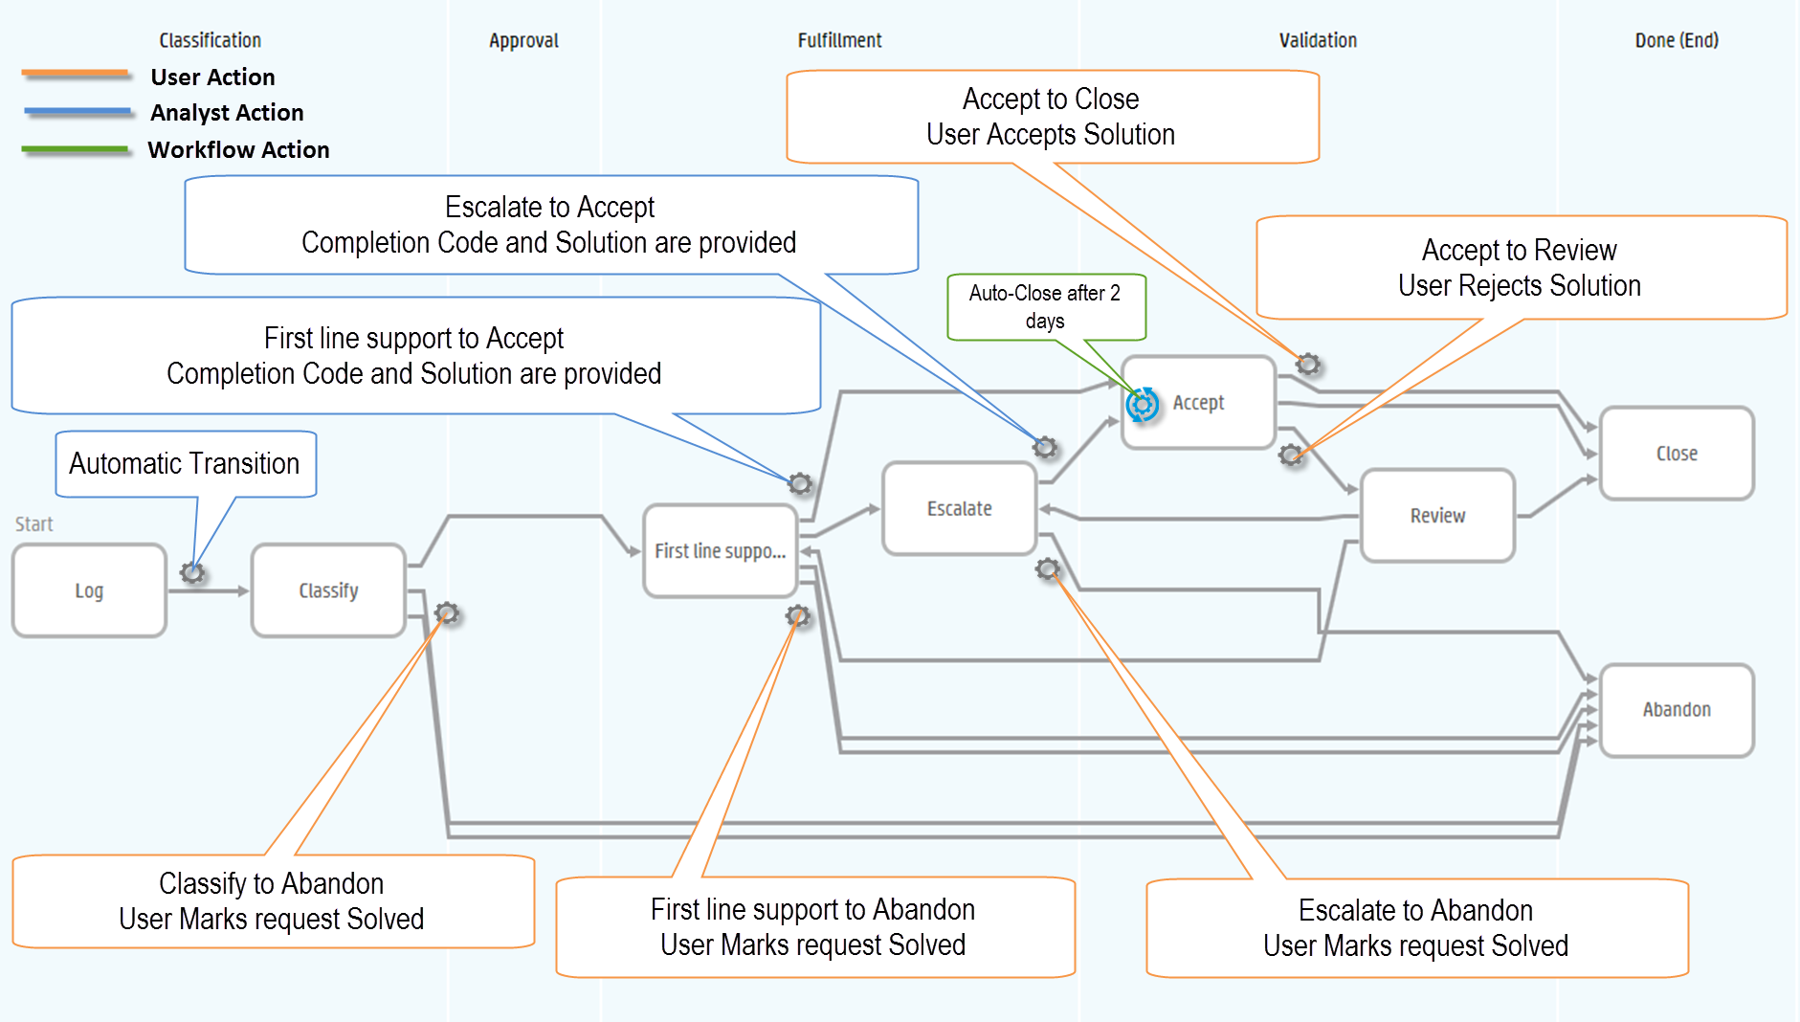
Support Request Workflow – Automatic Transitions

Slide 19
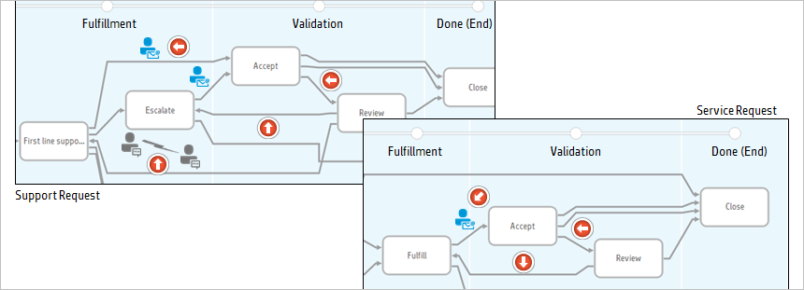
Request Validation
When a request is fulfilled an e-mail is sent to the requestor
the requestor can accept or reject solution
The service request agent may choose to escalate the request if solution is not accepted by user
During escalation, the agent can start a discussion with others to find the right solution
Before a request can be closed, it must be validated by the individual who initiated the service or support request. The end user can either accept or reject the support solution or service completion. A rejection moves the request into a review phase, where the Service Request agent determines the necessary steps to find the proper solution. This can involve escalating the issue or pooling additional resources to solve the issue.
Notes:
Before the request can be closed, it must be validated by the individual who initiated the request. The requestor can:
Accept – accept the solution, which closes the request
Reject – rejects the solution, which moves the request to the Review phase

Slide 20


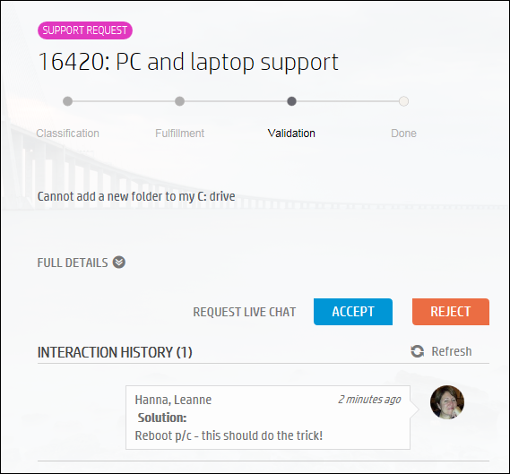
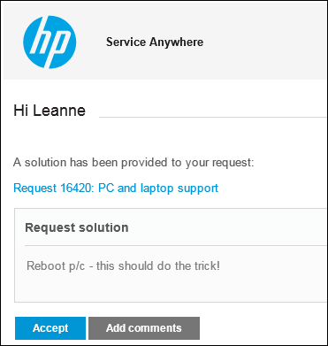
User Communication – Accept / Reject
Customer action in portal
Customer email
User Clicks to Accept or Reject
User Clicks to Accept or Reject
User can click any link to go into Self Service Portal
User can click any link to go into Self Service Portal

Slide 21
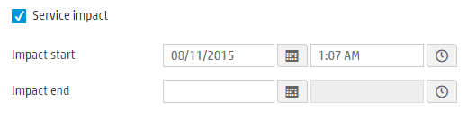
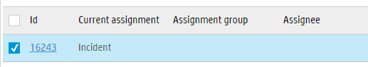
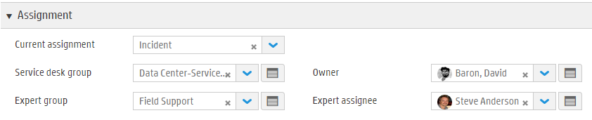
Incident Automatic Creation and Quick Close
Request to Incident flow
Automatic creation of Incident from Request
‘Service Impact’ checkbox field
If checked the request must be linked to an incident
If no incident is linked then one is created
Current Assignment field set to ‘Incident’ to indicate that the request is being worked in the Incident process
Request is no longer assigned
Service Desk Group and Owner are still set
Quick Incident Resolve from Request
Add Solution and set Completion code on the Request
This will set the related Incident Solution and Completion code
Incident resolved -> Resolved successfully
Resolved with workaround -> Resolved with workaround
Unable to reproduce -> Not reproducible
Abandoned by user -> Withdrawn by user

Slide 22
Service Request Workflow

Slide 23
Service Request Workflow

Slide 24
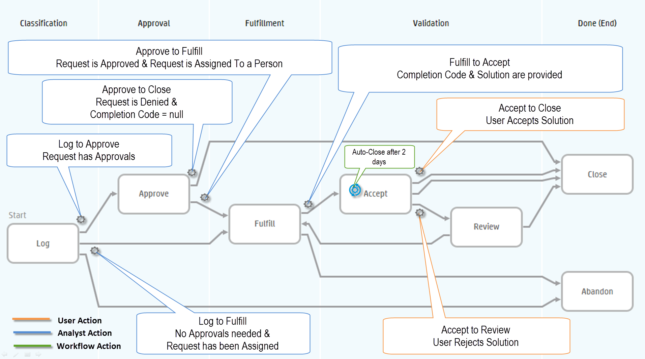
Service Request Workflow – Automatic Transitions

Slide 25
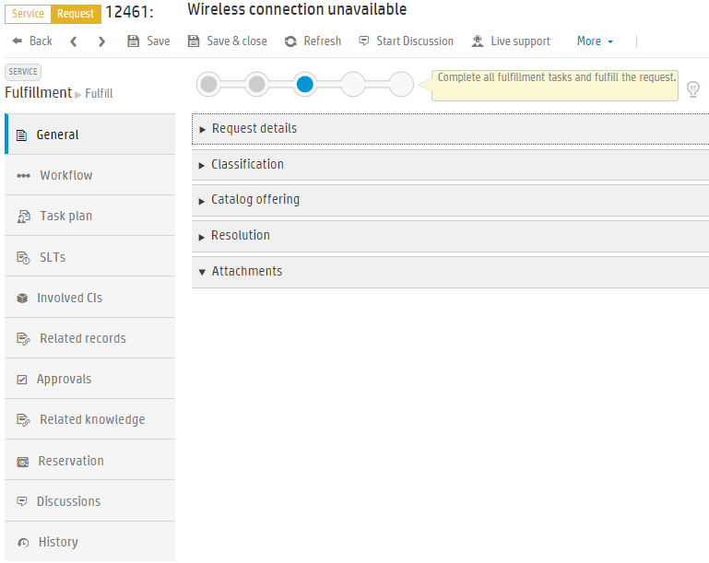
Service Request
Record content

Slide 26
Live Support

Slide 27
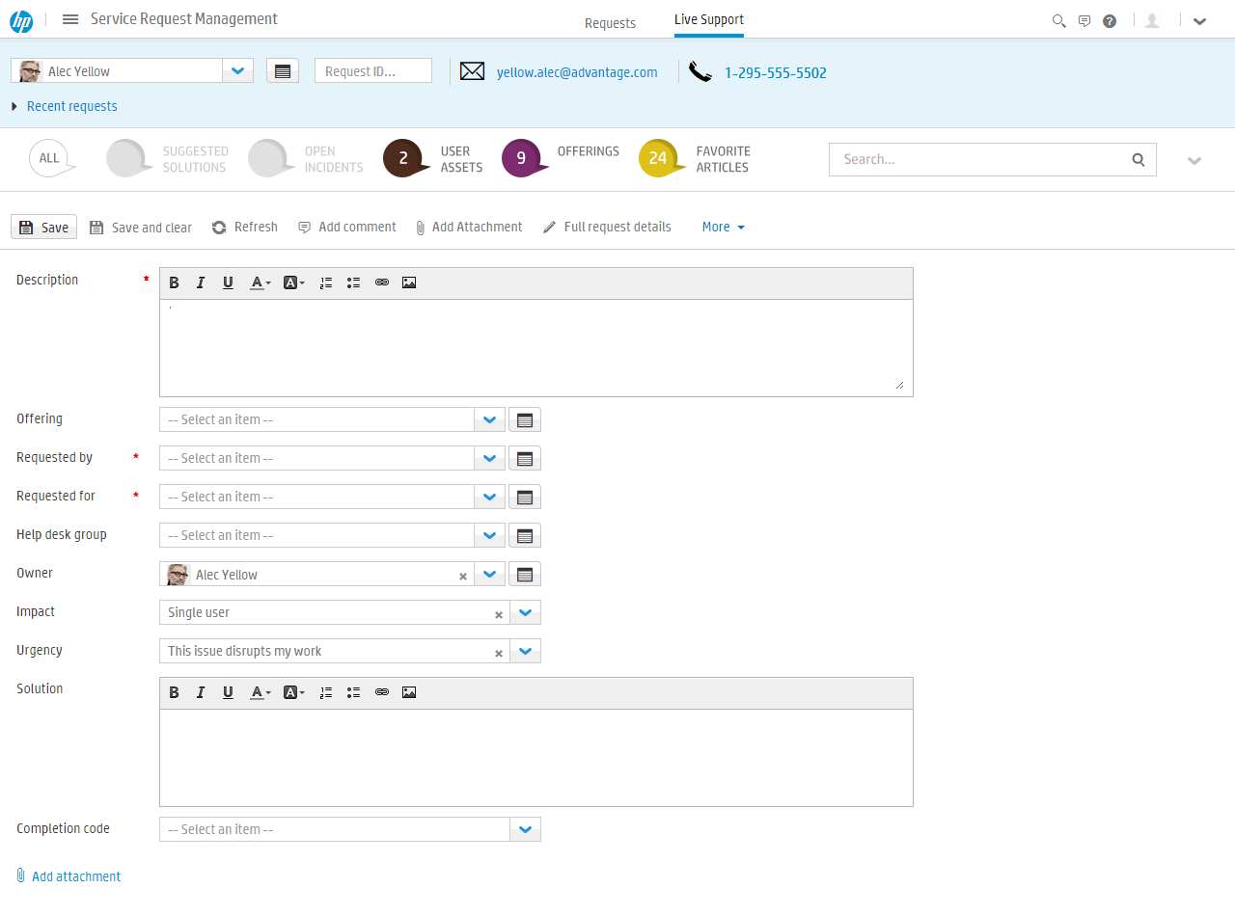
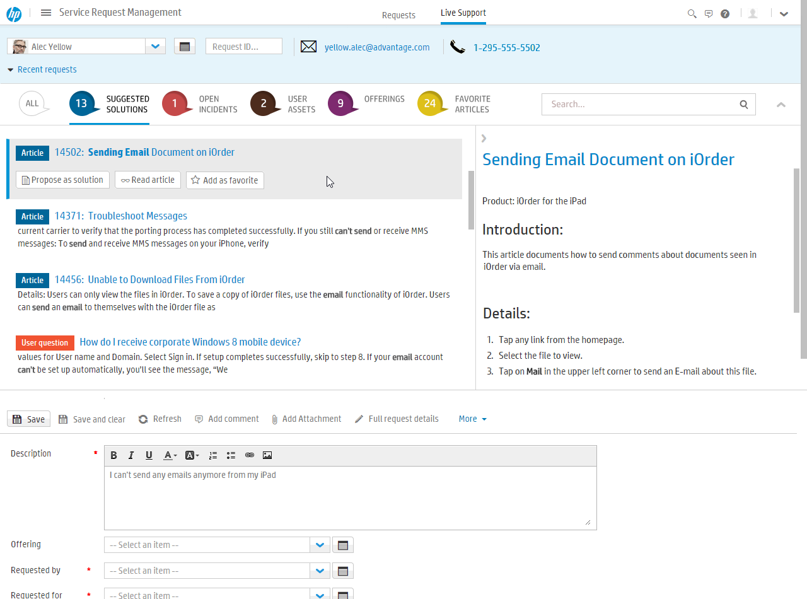
Live Support & Computer Telephony Integration
Agent “Live Support”
Optimized experience for live phone/chat based support, minimize clicks and maximize productivity
Caller details – including their recently opened requests
Context driven proactive suggestions of Solutions and Support Offerings
IDOL powered auto-suggested field values
Open and resolve within a single pane
Computer Telephony Integration (CTI)
Take calls and quick start tickets with pre-populated caller information
Notes:
To access, navigate to Service Request Management, and click on the Live Support subtab.

Slide 28
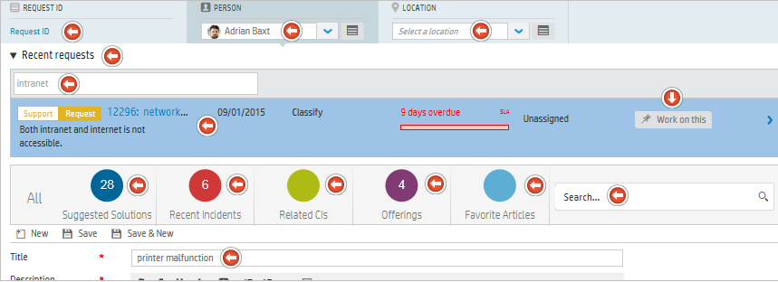
Live Support & Computer Telephony Integration
Live Support, minimize clicks and maximize productivity
Caller details, including their recently opened requests
Context driven proactive suggestions of Solutions and Support Offerings
SRM includes Live Support for dealing with telephone support calls. With the appropriate configuration and a Computer Telephony Integration (CTI) system, Live support provides key information and tools that can help to efficiently process new service requests and inquiries received by telephone.
Notes:
Optimized experience for live phone based support, minimize clicks and maximize productivity
Caller details – including their recently opened requests (Open requests are displayed first, with the most recently created first. They are followed by the closed requests, with the most recently closed shown first. Select a request or type keywords in the search box to quickly locate matching requests)
Context driven proactive suggestions of Solutions and Support Offerings : IDOL powered auto-suggested field values
Computer Telephony Integration (CTI) : Take calls and quick start tickets with pre-populated caller information

Slide 29
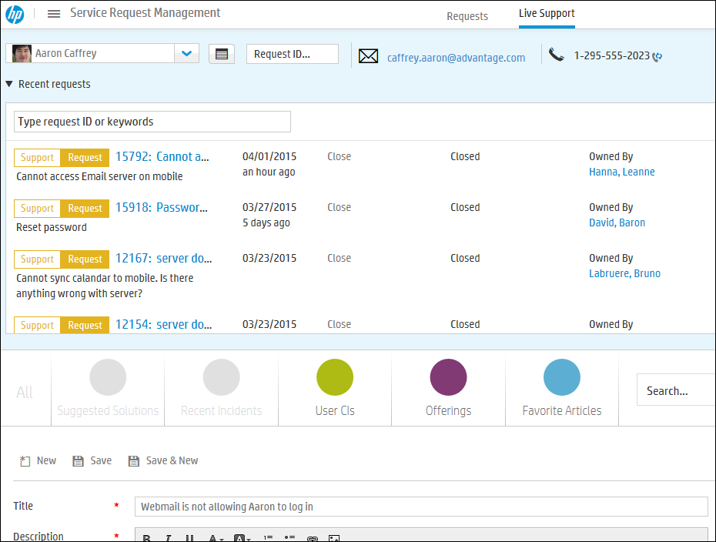
Real Time Support & Computer Telephony Integration
Collapse Recent requests
Agent “Live Support”
Optimized experience for live phone/chat based support, minimize clicks and maximize productivity
Caller details – including their recently opened requests
Context driven proactive suggestions of Solutions and Support Offerings
IDOL powered auto-suggested field values
Open and resolve within a single pane
Computer Telephony Integration (CTI)
Take calls and quick start tickets with pre-populated caller information
Caller details
Recent requests list
Search
New ticket logging
Suggestions bar
Notes:
Suggestions bar (see Help Center):
All - Based on relevance to the entered text, an aggregated list of suggested solutions from the following sources:
Articles
Incidents - open and closed
Offerings
Questions
Requests
Suggested Solutions - Based on relevance to the entered text, an aggregated list of suggested solutions from the following sources:
Articles
Incidents - closed
Questions - with answers
Requests - closed
Recent Incidents - Based on relevance to the entered text:
Incidents that are open
Incidents that were closed within the preceding week
Related Cis - Displays CIs that are both:
Related to the person selected, and
In the In use or Retiring metaphase of their workflow
Offerings - All offerings which are potential solutions, based on the following:
Relevance to the entered text
Entitlement rules applying to the caller
Favorite Articles - Your favorite articles

Slide 30
Social Support

Slide 31
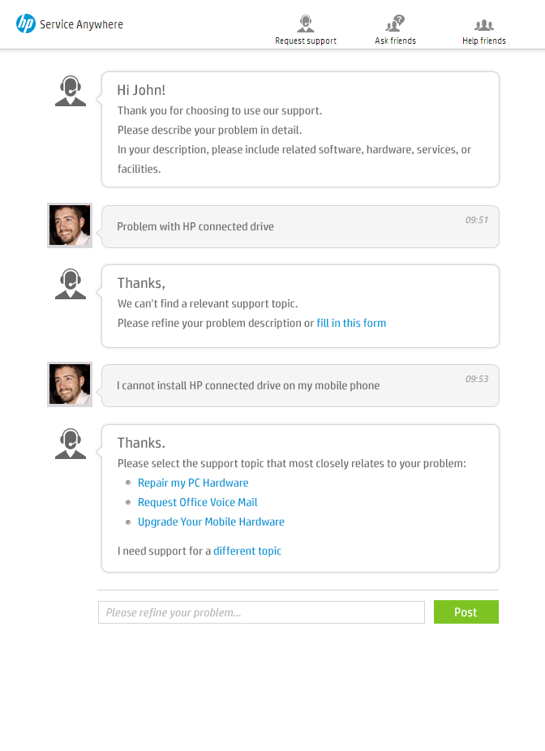
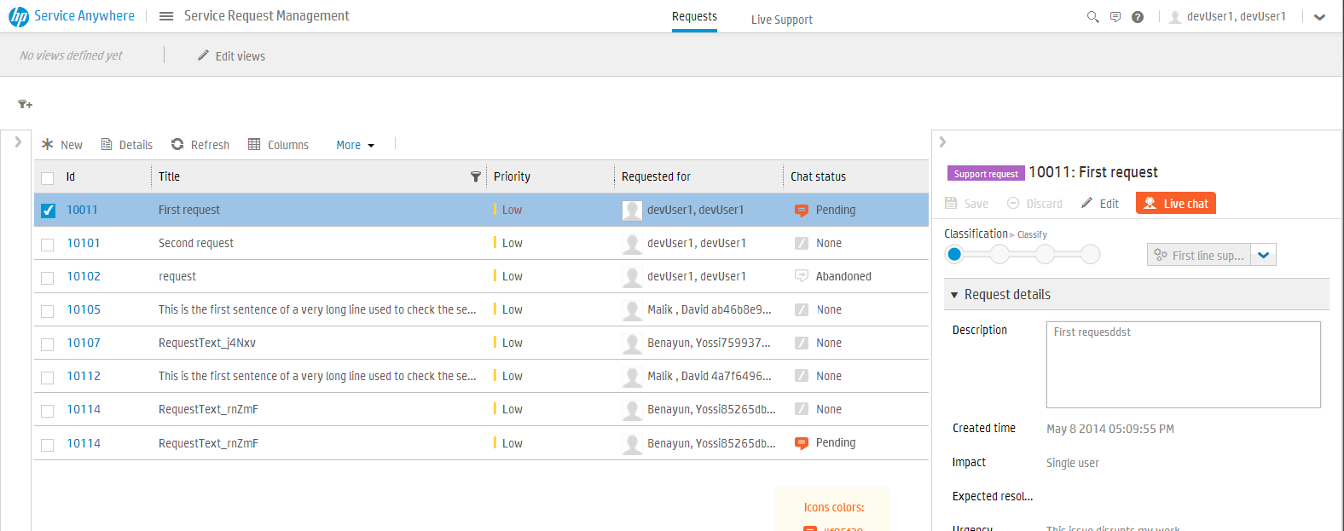
Agent to End User Smart Chat
View and deal with chat requests from users
Self-Service Chat
Bot-assisted Support
Users guided to appropriate Service and Support Offerings
Live chat with IT Agent
Agent Chat Queues
Manage service specific Chat enablement settings and schedules
Dynamic chat work queues
Live support assisted experience – assisted by proactive knowledge

Slide 32
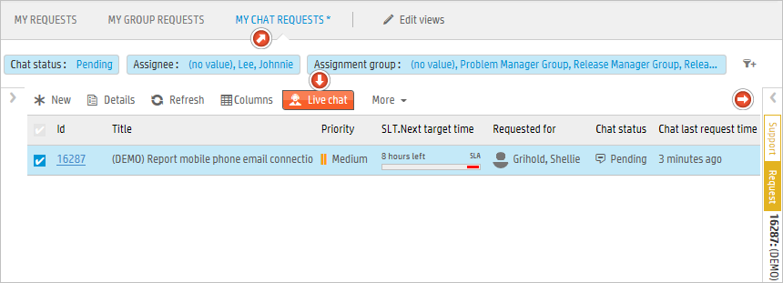
Agent Chat Queue
Chat requests are systematically queued so service desk groups can efficiently deliver timely and ordered responses, and management can monitor demand and performance. Automatic systems ensure that a suitable message is delivered for out-of-hours requests. The agents can deliver live support backed up by proactive knowledge that can help resolve issues quickly and increase en-user satisfaction

Slide 33
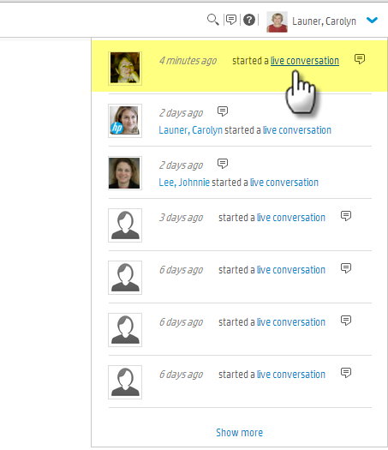



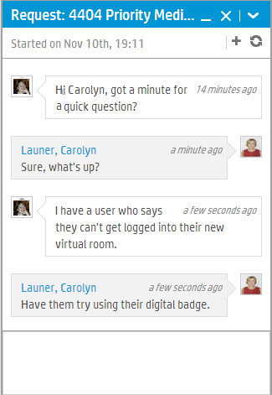
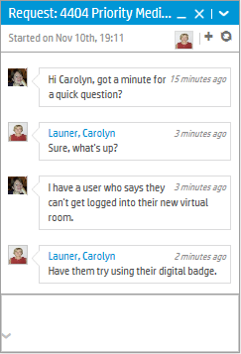
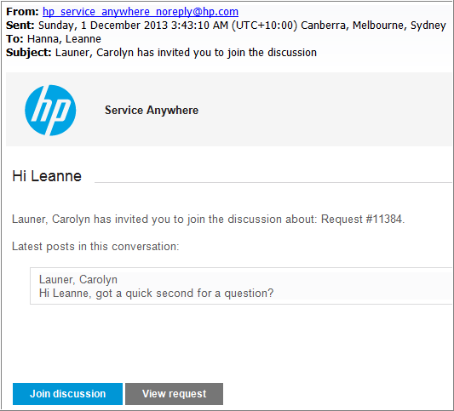
Discussion between Agent and Subject Matter Experts
IT Agent
IT SME

Slide 34
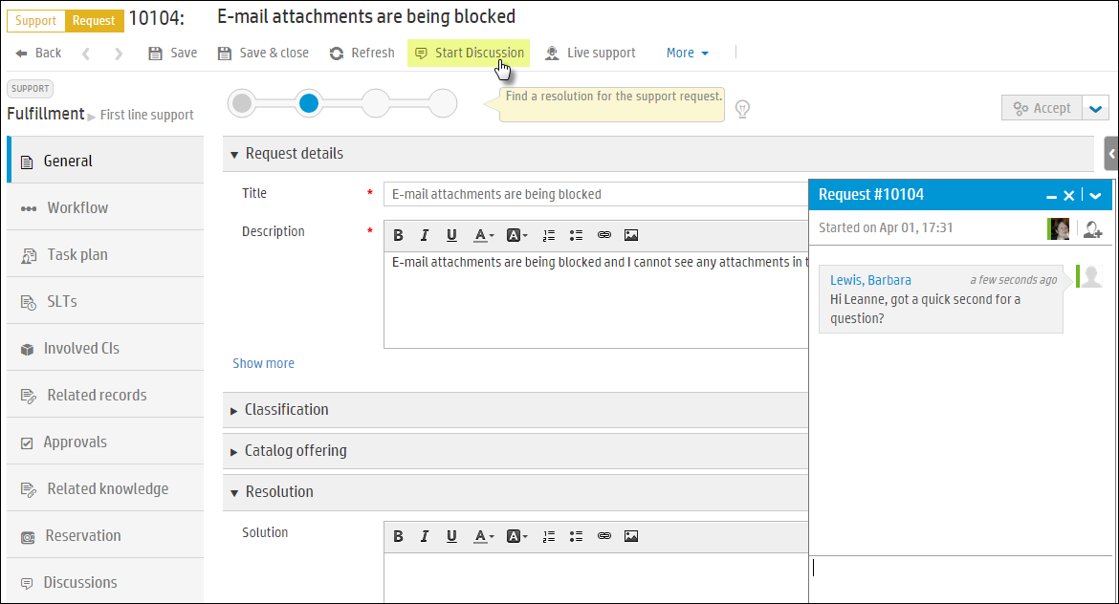
Social Collaboration
Start Discussion
From the Action Toolbar
Change the discussion title
Go to item details
Select participant(s)
Search & select name(s) from the drop-down
Green bar next to avatar indicates person is a SAW user
Displays additional panel on left of discussion for multiple participants
Minimize or Close discussion
Discussions saved with the request

Slide 35
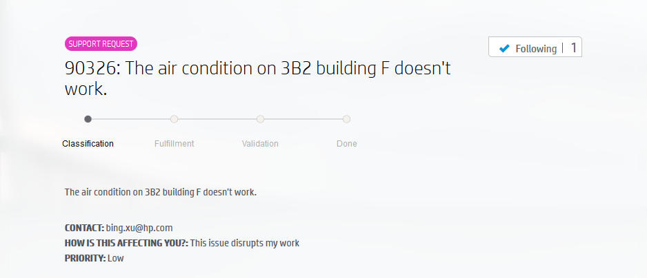
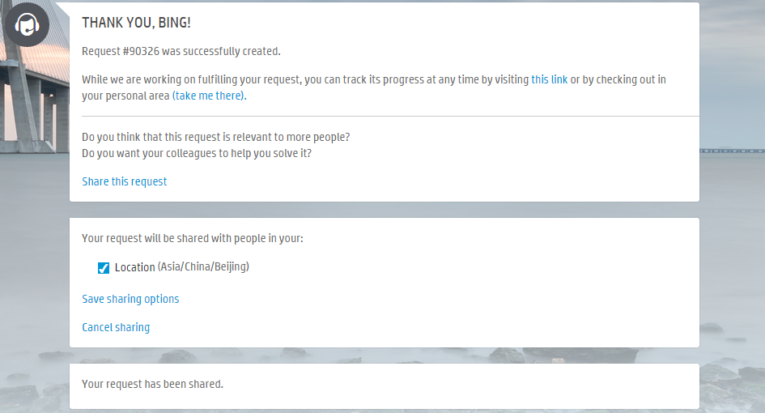
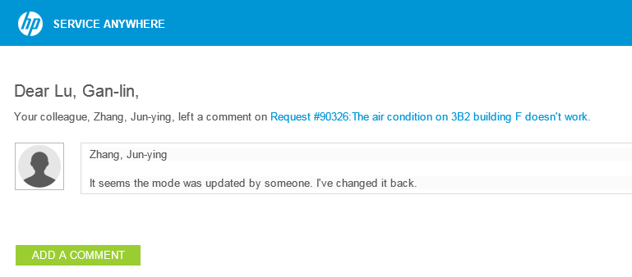
Public Requests help users in the portal
Share what is happening around you
Share, Follow, Get notification
Notes:
A user can share their request.
When the request is opened Service Anywhere responds with some questions
Do you think this request is relevant to more people?
Do you want your colleagues to help you solve it?
The user then has the option to click on Share this request
If they do chose to share the request is shared with people in their location or organization
In the second screenshot you see the result of this collaborative approach
A colleague has responded to Bings request with information that should help

Slide 36
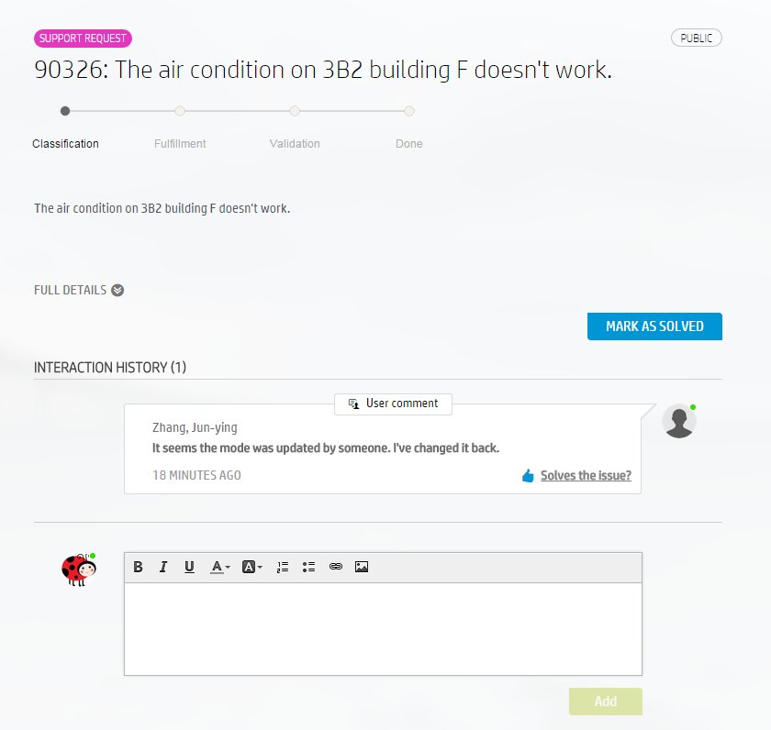
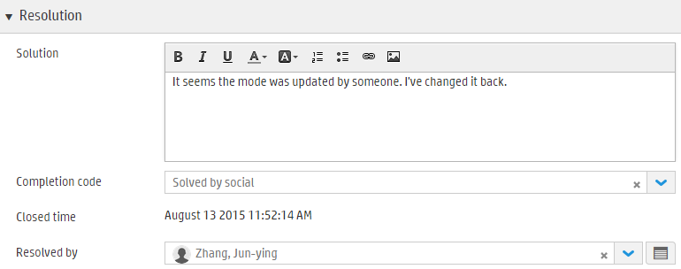
Public Requests help agents
Reduce volume of tickets
Avoid creation of duplicated tickets
Accelerate ticket solving
Notes:
And finally this social support speeds up the resolution process

Slide 37


Lab Exercises
5.0 Exercise Create and Resolve a Support Offering Request

